Slide 1
Automatic Guitar Tuner
Trenton Ahrens, alex capo, Ernesto wong
Group 1

Slide 2
Motivation
Tuning can be time consuming
Difficult without extra equipment especially for beginners
The interest in music

Slide 3
Specifications
Tune within 30 seconds
Within a noticeable difference of +/- 5 cents (100 cents/semitone)
5 tuning preferences on Android application
At least 24 hours of battery life

Slide 4
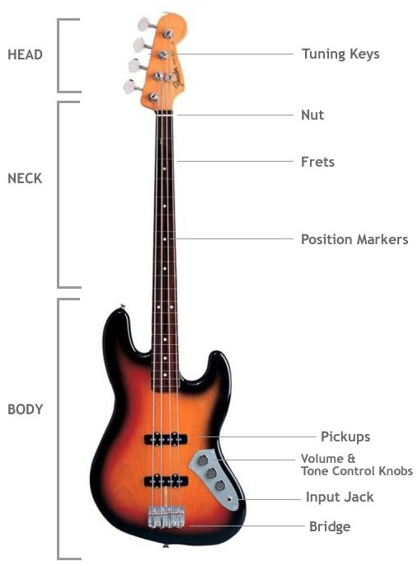
4-String Bass

Slide 5
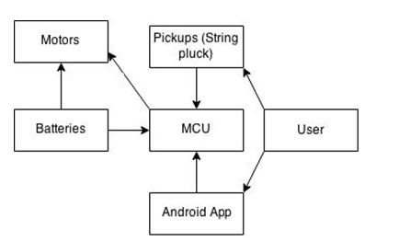
Overall System Block Diagram

Slide 6
Division of Labor
Ernesto
Android app development
Code for tuning algorithm
Bluetooth communication
Trenton
Signal Processing
Mounting
PCB design
Alex
Power supply
Mounting
Code for tuning algorithm

Slide 7
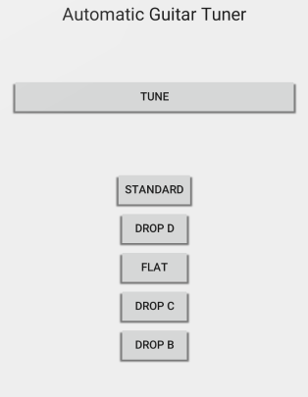
Mobile Application
User Interface
Android Platform Version 4.4.X+
Android Studio
Java
Bluetooth communication with microcontroller
Defined MAC address for module

Slide 8
Android Studio IDE
Java language
Object-Oriented
Class (.java file)
Define variables and methods
Layout (.xml file)
Widget (ie. buttons, text field) placement
Android Manifest
Bluetooth Permissions

Slide 9
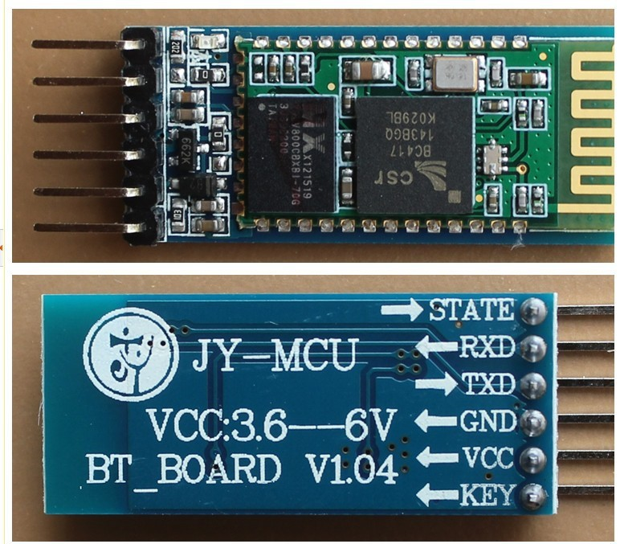
Bluetooth Communication
Built in Bluetooth capabilities on phone
HC-05 Bluetooth module
5V VCC with 3.3V logic level Rx

Slide 10
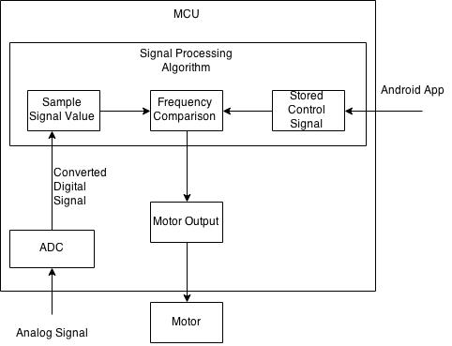
Microcontroller
ATMega328p chip
6 analog inputs 10-Bit ADC
12 Digital inputs/outputs
16 MHz operating freq.
24 pin dip package
C++ (Arduino bootloader)

Slide 11
Pickups
Magnetic field seen by the pickups will induce an analog voltage that will be read by the ADC inputs
Magnetic single coil pickups

Slide 12
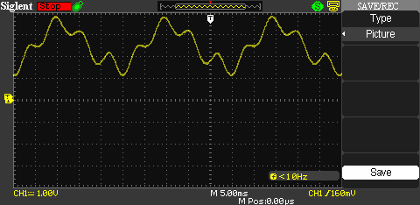
Frequency Calculating
Midpoint crossings (2.5V)
Timer to determine period
T = 1/F
ISR

Slide 13
Motor Control
Follows algorithm based on string, tuning preference
+/- 0.2 Hz threshold

Slide 14
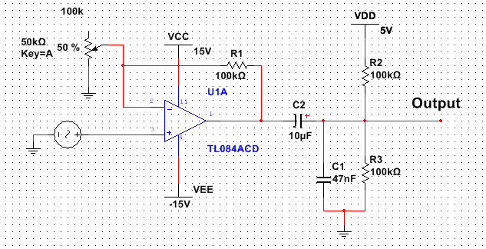
DC Offset & Amplification
Guitar signal from pickups is about 20mV-40mV
ADC 0-5V
$A=1+\frac{R_{2}}{R_{1}}$
DC offset to 2.5V

Slide 15
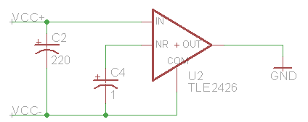
Rail Splitter
TLE2426 “Rail Splitter”
Creates virtual ground
More stable than two individual batteries

Slide 16
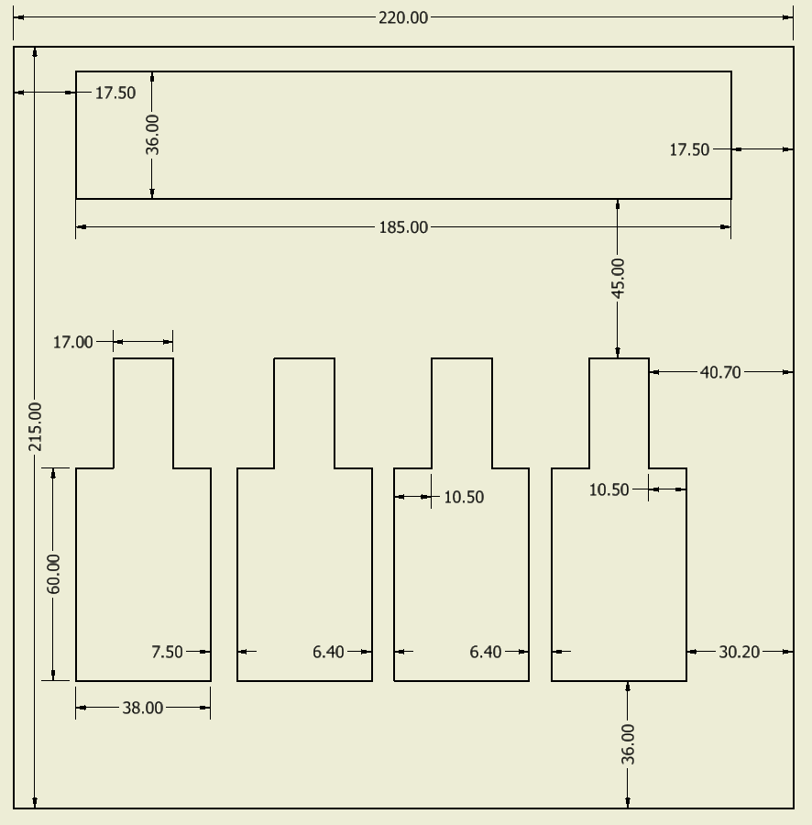
Motor Mounting Bracket
22 gauge sheet metal

Slide 17
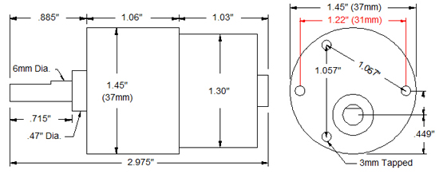
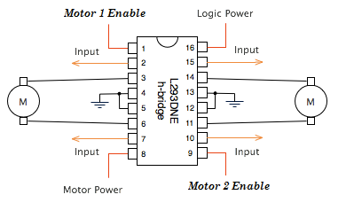
Tuning Mechanism
ROB 12472 standard gear motor
3-12 V operational input
38 lb-in torque
Bi-directional rotation
H-Bridge driver (L293DNE)
1A output
2 H-Bridge per chip

Slide 18
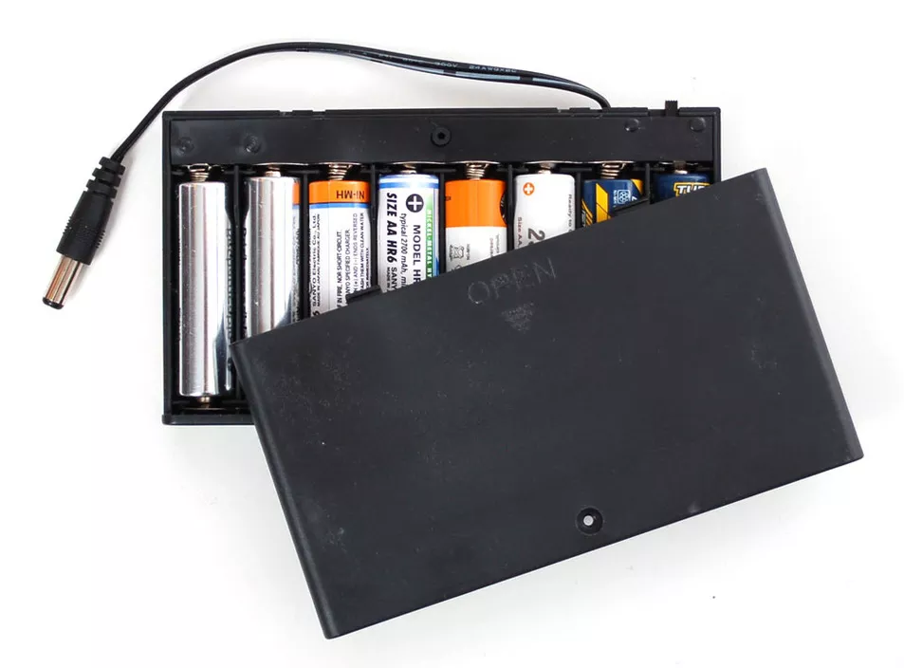
Power
Battery Power – NiMH (Nickel Metal Hydride) rechargeable batteries
8xAA battery holster (Adafruit) = 9.36 V 2500 mAh
2x9V batteries in series = 18V

Slide 19
Components to be Powered
Atmega328p (Amazon) 1.8-5V Operating voltage 0.2mA current draw while active
4x ROB-12472 Standard Gear Motor (Sparkfun) 3-12V operating voltage 95mA current draw @ 12 V
HC-05 Bluetooth 5 V
TL082CP OP Amp +/- 9 V
4xMotor(95mA) + Atmega328p(0.2mA) = 380.2mA
2500mAh/380.2mA = 6.57 hours battery life
2500mAh/95.2mA = 26.26 hours battery life (realistically)

Slide 20
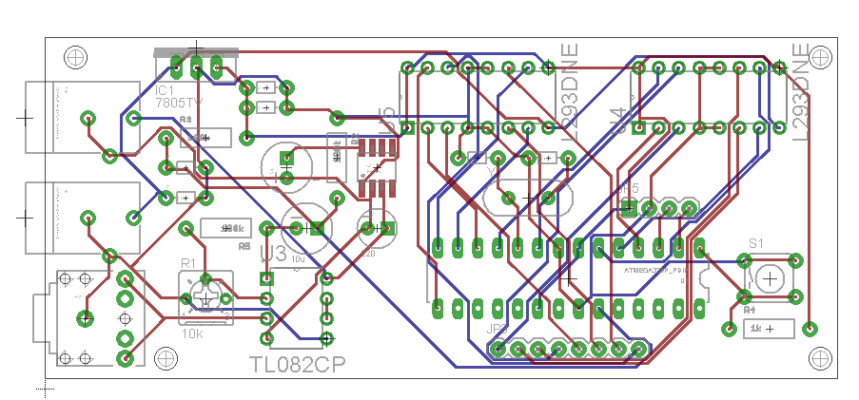
PCB Design
Eagle 7.2.0 light edition
OSH Park

Slide 21
Component Decisions
6-String Electric Guitar vs. 4-String Bass Guitar
Polyphonic vs. Single Coil
ATmega328p
Threshold crossings vs. FFT
Gearmotor vs. Stepper vs. Servo
NiMH vs. Li ion
IC H-Bridge vs. DIY H-Bridge
Android > Apple

Slide 22
Operational Procedure
Power on device tuning box
Select tune (T) on switch to select tuning
Activate Bluetooth on mobile application
Open Android application on mobile device
Connect mobile device to Bluetooth module
Select tuning preference
Tune strings

Slide 23
Difficulties
Mounting of motors
Cutting sheet metal
Aligning motors
Bluetooth communication
3.3V signal level
Error message on app use
3 out of 4 motors working
Pinout configuration on the board and in the code

Slide 24
Budget
Part | Cost
4-String Bass Guitar | $0
4x Gear motors ROB-12472 | $ 119.96
Arduino Uno | $25.75
HC-05 Bluetooth module | $8.40
Shaft couplers & motor mounts | $46.00
2x H-Bridge (L293DNE) | $14.49
Sheet metal bracket | $20.00
Misc. wire & passive components | $20.00
Funding provided by Boeing : $200
Total: $254.60

Slide 25
Questions?

